Slide 1
Pecunia : Banking System
Developed by Team F
Aditya Khatavkar
Aishwarya Sarna
Akshay Tople
Ayush Soni
Samanway Sahoo

Slide 2
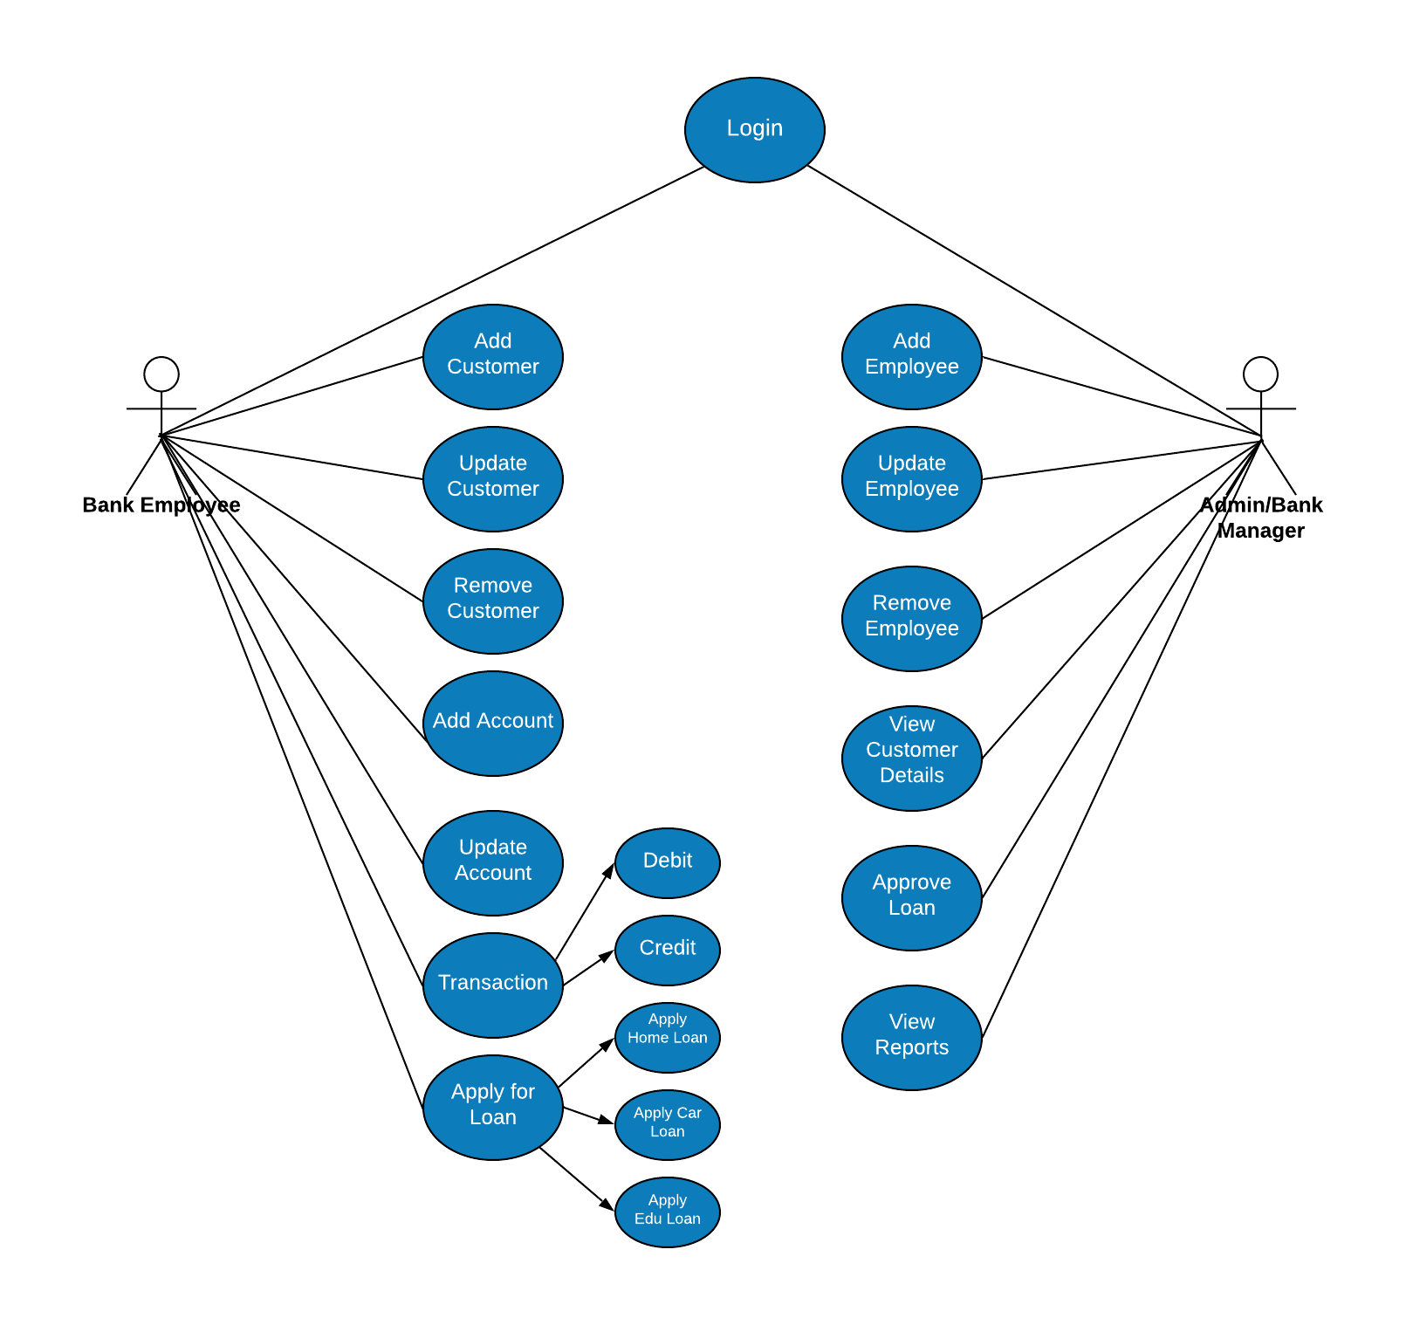
USE CASE DIAGRAM

Slide 3
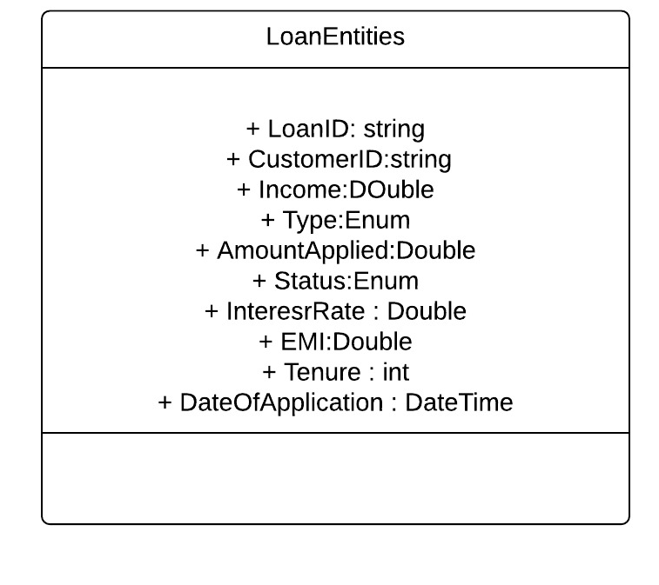
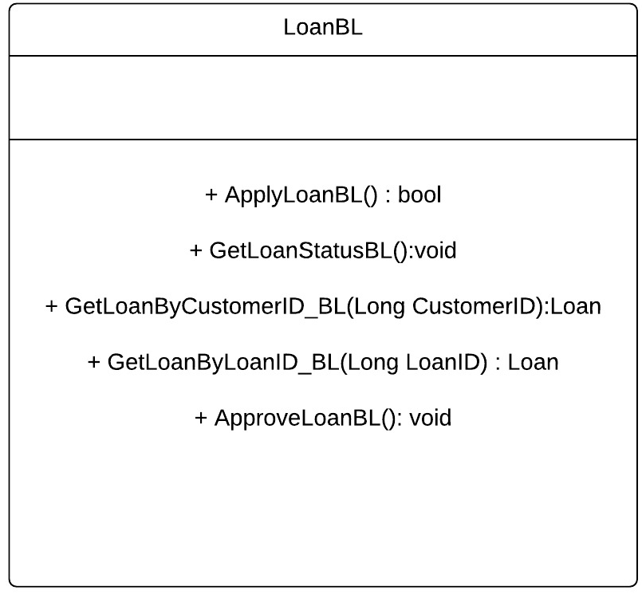
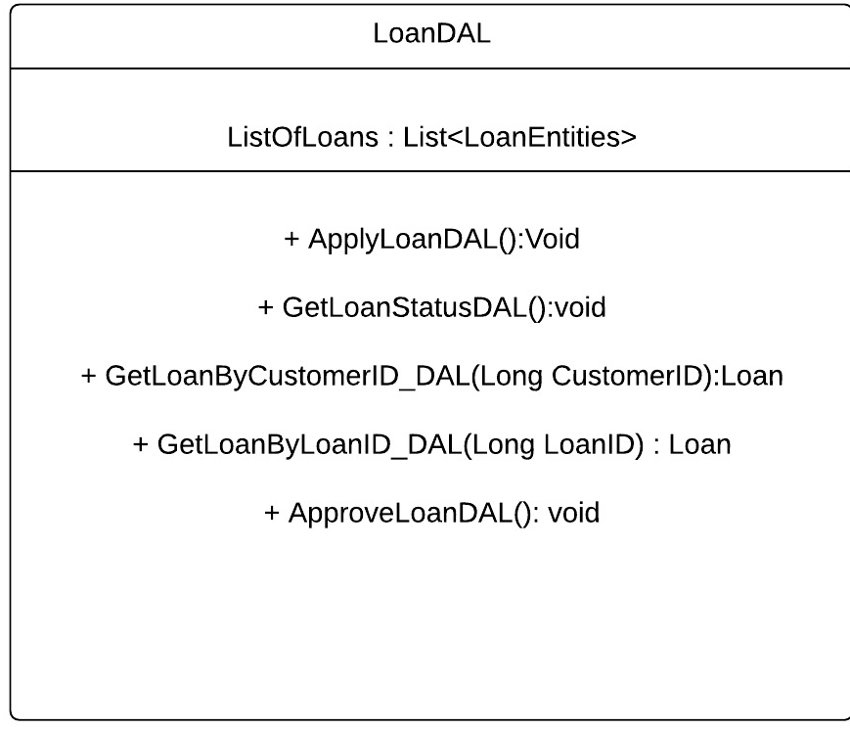
Class Diagrams

Slide 4
EPIC and User Stories
EPIC : Develop Utility Management Functionality
User Story 1: As a bank employee I want to have access to utilities, so that:
1) I can Issue Cheque Books
2) I can Issue/Block Credit Cards
3) I can Issue/Block Debit Cards
EPIC : Develop Employee Dashboard
User Story 1: As a bank employee i want to be able to access the Account Management, Transaction Management, Loan Management, Utility Management, Passbook Management, so that:
1) All functionalities are easily accessible and every activity is logged in an encrypted way
2) Delay is not more than 15 seconds.
3) Login is 2 factor-verified.

Slide 5
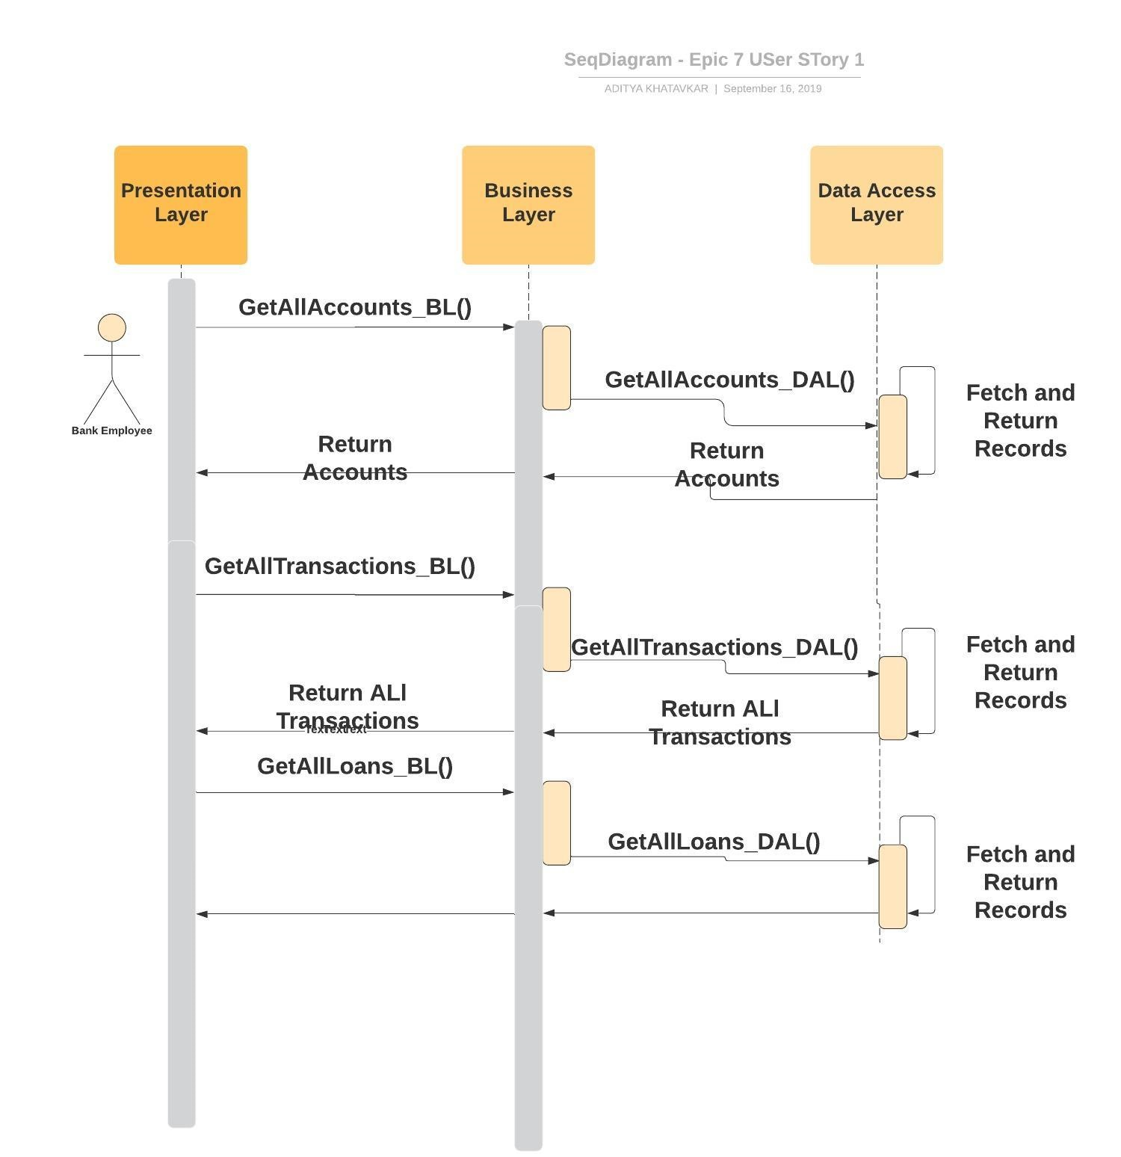
Sequence Diagram : Utility Management System

Slide 6
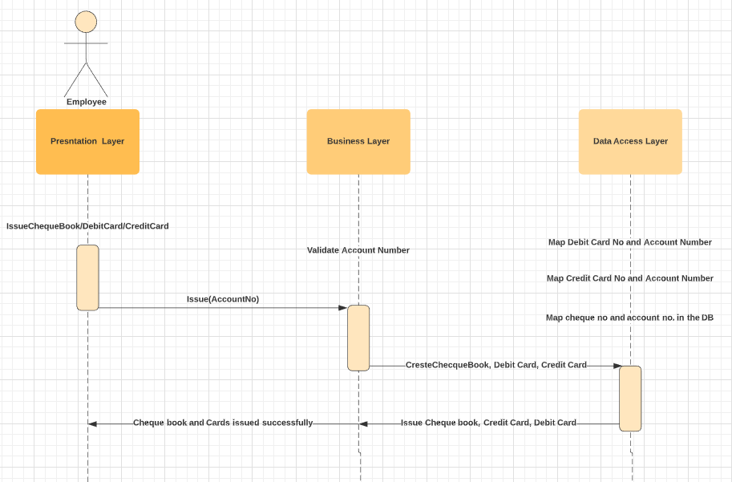
Sequence Diagram : Issue Cards

Slide 7
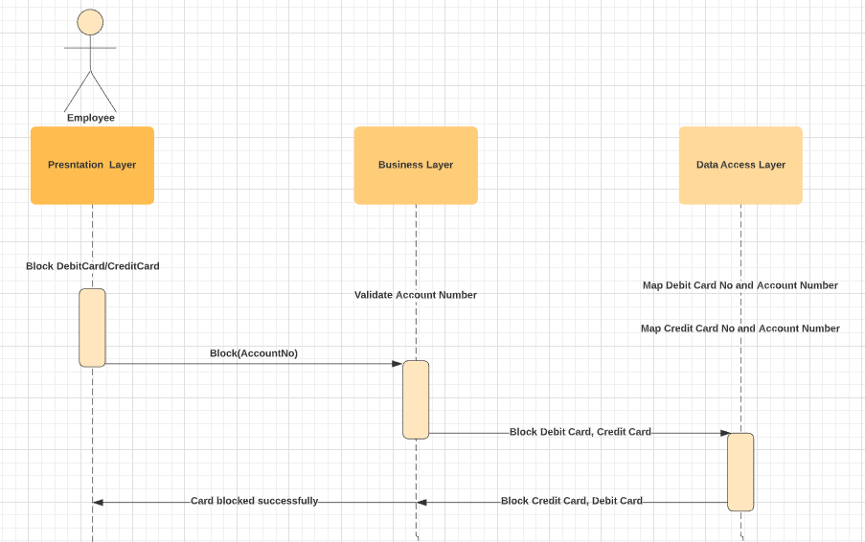
Sequence Diagram : Block Cards

Slide 8
Thank You

